Slide 1

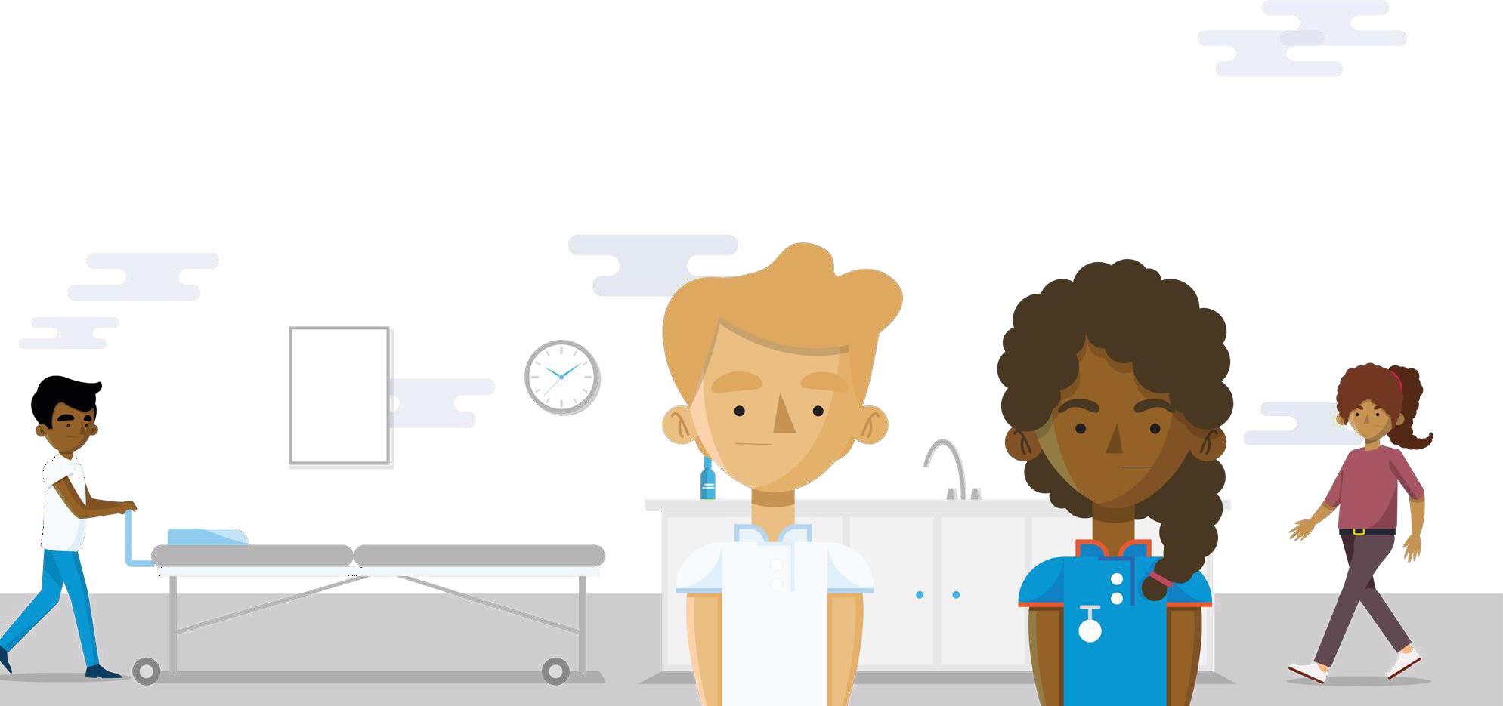
Supporting Our NHS People
Helping you manage your own health and wellbeing whilst looking after others

Slide 2



Our offer to you
The NHS People Plan sets out a series of national health and wellbeing ambitions that aim to create cultures of wellbeing across the NHS, where colleagues feel looked after and cared for. Through the response to the pandemic and now more than ever, our NHS people deserve a comprehensive package of emotional, psychological and practical health and wellbeing support.
As well as the national intentions outlined in the NHS People Plan, a range of guides, apps and resources that aim to support both your individual wellbeing and that of your team are available at: www.england.nhs.uk/people
You can also contact the national team By email: ournhspeople.hwb@nhs.net By Twitter: @people_nhs
All offers and resources outlined in this pack are correct as of July 2021.

Slide 3
Contents
Pages | Content
4-5 | Support now
6-8 | Counselling and talking therapies
9 | Wellbeing conversations
10 | Bespoke support for primary care colleagues
11-13 | Wellbeing and self help apps
14- 15 | Physical health and wellbeing and Digital weight management
16 | Substance misuse and gambling support
17 | Financial wellbeing
18 | Support for parents
29 | Staff mental health hubs
20 | Online guides and resources
21-23 | Bespoke support for leaders and senior leaders
24 | Growing occupational health

Slide 4

Support now
Staff support line
We have a confidential staff support line, operated by the Samaritans and free to access from 7:00am – 11:00pm, seven days a week.
This support line is here for when you’ve had a tough day, are feeling worried or overwhelmed. Whatever your worries, trained advisers can help with signposting and confidential listening.
Call: 0800 069 6222
Alternatively, you can text FRONTLINE to 85258 for support 24/7 via text
Find out more: https://www.england.nhs.uk/supporting-our-nhs-people/support-now/

Slide 5
Support now
Bereavement support line
We also have a confidential bereavement support line, operated by Hospice UK and free to access from
8:00am – 8:00pm, seven days a week.
A team of fully qualified and trained bereavement specialists are available to support you with bereavement and wellbeing issues relating to loss experienced through your work.
Call: 0300 303 4434
Bereavement and trauma support line for our Filipino colleagues
There is a team of fully qualified and trained professionals, all of whom are Tagalog speakers, ready to help you at our NHS Bereavement & Trauma Line for Filipino Staff. This assistance is available from anywhere in the country and is provided by Hospice UK.
All calls will be treated in the strictest of confidence and this will be explained to you when you call. This service is available seven days a week, between 8:00am and 8:00pm. You do not need a referral.
To book a consultation, call: 0300 303 1115
Find out more: https://www.england.nhs.uk/supporting-our-nhs-people/support-now/

Slide 6

Counselling and talking therapies
Counselling support from the Association of Christian Counsellors
A free service developed and funded by the Association of Christian Counsellors, who are offering up to 8 online or telephone counselling sessions from qualified counsellors at flexible appointment times by video or telephone, for:
NHS clinical and non-clinical staff working with Covid-19 patients in a hospital setting
Ancillary staff working in Covid-19 areas in hospital settings including cleaners, porters and mortuary
workers
Paramedics and anyone working within the ambulance services caring for patients with Covid-19
The confidential service is open to people of all beliefs and none. You can also ask to be matched with a counsellor by ethnicity.
Find out more: https://www.england.nhs.uk/supporting-our-nhs-people/wellbeing-support-options/support-offers/

Slide 7

Counselling and talking therapies
#Looking after you too: Coaching support for our Black, Asian, Minority Ethnic colleagues
This programme has been developed to support any NHS colleagues who identify as part of our Black, Asian, and Minority Ethnic workforce in NHS and ambulance trusts, in maintaining their psychological wellbeing during this challenging time.
This individually tailored coaching support will focus on proactively supporting you to process experiences, offload the demands of whatever you are experiencing, deal with difficult conversations, develop coping skills and be supported in developing practical strategies.
The programme is currently closed to new bookings, please visit the webpage from August onwards for new sessions.
Find out more: https://www.england.nhs.uk/supporting-our-nhs-people/support-now/support-for-our-diverse- colleagues/

Slide 8

Counselling and talking therapies
Islamic mental health and wellbeing service
Free faith-based mental health counselling support for Muslims working in the NHS. Inspirited Minds and the Lateef Project have partnered with the NHS to provide a confidential and Islamic-based counselling service for our NHS people, delivered by qualified counselling therapists.
For more information, please visit: https://inspiritedminds.org.uk/nhs https://www.lateefproject.org/get-support
Find out more: https://www.england.nhs.uk/supporting-our-nhs-people/support-now/support-for-our-diverse- colleagues/

Slide 9
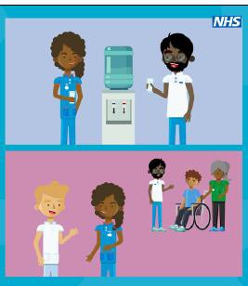
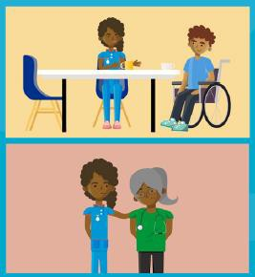
Wellbeing conversations
Resources to support you when approaching and holding a wellbeing conversation
The wellbeing of our NHS and social care colleagues can be affected by all kinds of factors at work. Workload, capacity, relationships with colleagues and the physical working environment can all have an impact. Likewise, factors outside work, including lack of sleep, financial worries, health conditions and caring responsibilities, can have an impact – especially if they have changed recently.
The NHS People Plan encourages us to hold regular, one to one, wellbeing conversations with our colleagues.
We have published a range of resources to support you in having a wellbeing conversation with your colleagues. These resources include a guide for line managers, an animation, several case studies and a staff experience video.
Find out more: https://people.nhs.uk/projectm/wellbeing-conversations/

Slide 10
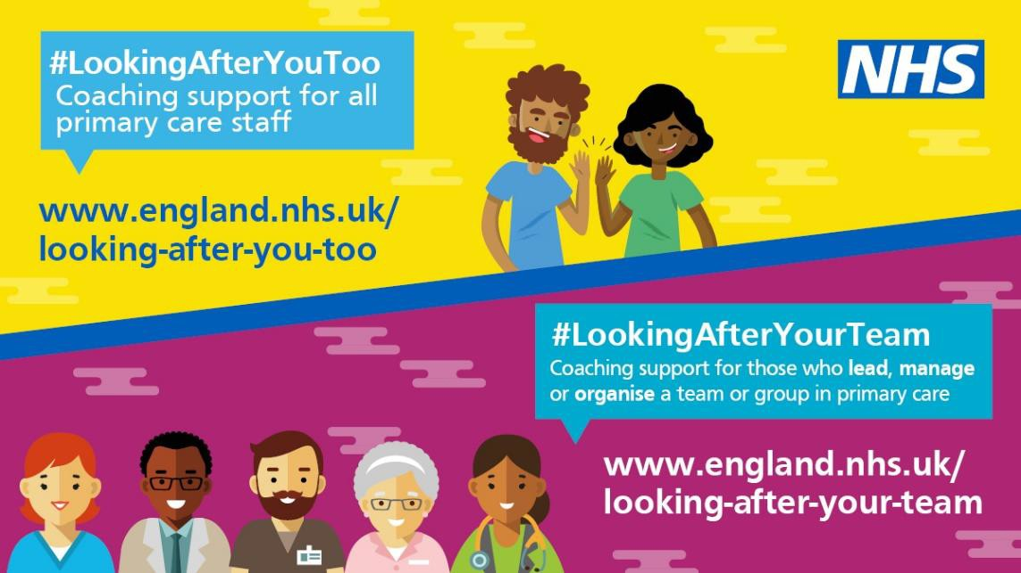
Bespoke support for primary care colleagues
#Looking after you too: Primary care coaching offer
Our primary care colleagues (including those working in both clinical and non clinical roles across general practice, dental, optometry and pharmacy services, have faced unprecedented challenges throughout the pandemic.
This individual coaching support offer is available to all primary care colleagues and is delivered by a highly skilled and experienced coach. This is a safe space to offload the demands of whatever you are experiencing and be supported in developing practical strategies for dealing with this. It might be that through a one-off conversation you have all the strategies you need to cope with your situation and stay well, or you might find a few sessions helpful.
Find out more: https://www.england.nhs.uk/supporting-our-nhs-people/wellbeing-support-options/looking-after- you-too/

Slide 11





Wellbeing apps
Throughout the pandemic, our NHS people have been offered free access to a range of mental health and wellbeing self help apps. Whilst we continue to review and develop a longer term digital health and wellbeing offer, access to the current apps has now been extended.
Our NHS colleagues are invited to sign up to these apps, using their work email address, for support with managing stress and anxiety, building resilience and taking a moment to be mindful.
Find out more: https://www.england.nhs.uk/supporting-our-nhs-people/support-now/wellbeing-apps/

Slide 12


Wellbeing apps
Headspace
Headspace is a science-backed app in mindfulness and meditation, providing unique tools and resources to help reduce stress, build resilience, and aid better sleep.
Free access has now been extended
until 31 December 2021.
Unmind
Unmind is a mental health platform that empowers staff to proactively improve their mental wellbeing. It includes digital programmes designed to help with stress, sleep, coping, connection, fulfilment and nutrition.
Free access has now been extended until
31 December 2021.
Find out more: https://www.england.nhs.uk/supporting-our-nhs-people/support-now/wellbeing-apps/

Slide 13


Wellbeing apps
StayAlive
The Stay Alive app is a suicide prevention resource for the UK, packed full of useful information and tools to help you stay safe in crisis. You can use it if you are having thoughts of suicide or if you are concerned about someone else who may be considering suicide.
BrightSky
Bright Sky is a free to download mobile app providing support and information for anyone who may be in an abusive relationship or those concerned about someone they know.
The app is also available to use in Polish, Punjabi and Urdu.
Movement for Modern Life
Movement for Modern Life is a British online yoga platform that brings together world class yoga teachers.
Free access has now been extended until 30 September 2021.
Find out more: https://www.england.nhs.uk/supporting-our-nhs-people/support-now/wellbeing-apps/

Slide 14

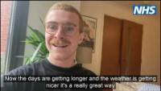
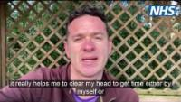
Physical health and wellbeing offer
Invictus Games Foundation Partnership
Looking after your physical health is key to supporting your overall health and wellbeing, including your mental health. As such, we are pleased to be working with the following organisations to offer physical health and wellbeing support to our NHS people..
We know it has been a tough year for everyone, but the best time to focus on your own physical and mental wellbeing is always now. That’s why we’ve partnered with Invictus Games Foundation, the partnership includes the launch of a series of podcasts that reflect on a variety of themes and a “5K our way” challenge, designed to help inspire and support our NHS people to step away from work and take time for themselves.
Find out more: https://www.england.nhs.uk/supporting-our-nhs-people/support-now/physical-health-and-wellbeing/

Slide 15

Digital weight management programme
Digital weight management programme for NHS staff
  This is a new and exciting programme being offered to NHS staff living with obesity, to provide the support needed to stay healthy and active.
  This programme offers NHS staff free, online access to a 12-week weight management programme which is designed to be personally tailored to support you on your journey to a healthier lifestyle. As a digital programme, it can be used anywhere, allowing you to complete the programme in your own time, at a pace that works for you.
  There is never a better time to look after your wellbeing. Keeping healthy and active can be a challenge, but this digital programme can help you make those small changes, one step at a time.
Find out more: https://www.england.nhs.uk/supporting-our-nhs-people/support-now/digital-weight-management-programme-for-nhs-staff/

Slide 16
Wellbeing resources
Substance misuse and gambling support
Recognising the increasing pressures on NHS staff, we have put together a range of information
on substance misuse and gambling support available through a number of organisations.
Substance misuse
Substance abuse or misuse can severely affect a person’s physical and mental health, and can impair their ability to function. It can equally cause harm to others around them. There are a range of services and helplines that can provide support for those who may need somebody to talk to.
Gambling
Problem gambling can have a devastating impact on individuals and families in all areas of life, including relationships, physical and psychological health and wellbeing, work and self-esteem. There is help available, not only for gamblers but also for their friends and family.
Find out more: https://www.england.nhs.uk/supporting-our-nhs-people/wellbeing-support-options/support-offers/

Slide 17

Wellbeing resources
Financial health and wellbeing support
We recognise that this is a difficult time for our NHS people and we know that financial concerns have consistently been in the top five reasons our people call the free support helpline run by the Samaritans.
We’ve partnered with the Money and Pensions Service to bring you financial wellbeing support to help you
manage your finances at home so you can:
Join one of our online financial wellbeing events
Visit the Money and Pensions Service for support, guidance and tools
Find out more: https://www.england.nhs.uk/supporting-our-nhs-people/wellbeing-support-options/support-offers/

Slide 18


Support for parents
Place2Be
Place2Be are offering an online programme of expert support and resources for keyworkers, including all NHS colleagues, to support the mental health and wellbeing of keyworker children.
The programme consists of three webinars and an Art Room resource pack for children and parents and carers to craft and create together. The webinars cover: recovery and self-care, understanding and managing anxiety in uncertain times, and understanding loss and bereavement.
Cityparents
Cityparents are offering our NHS people access to their online programme that includes positive and practical support for working parents, delivered through expert-led webinars/seminars, advice, peer insights, online articles, blogs and podcasts.
They aim to help working parents and those with caring responsibilities develop skills, enhance family life, improve wellbeing and support work/life balance.
This app is now free until 30 June 2021.
Find out more: https://www.england.nhs.uk/supporting-our-nhs-people/wellbeing-support-options/support-offers/

Slide 19
Staff mental health and wellbeing hubs
Staff mental health hubs
The staff mental health and wellbeing hubs have been set up to provide healthcare colleagues rapid access to local evidence-based mental health services and support where needed. The hub offer is confidential and free of charge for all healthcare staff. The hubs can offer you a clinical assessment and supported referral to the support that you need, such as talking therapy or counselling. It is separate and confidential from your organisation.
It is open to all healthcare staff, from all services and settings regardless of whether you are dealing directly with COVID-19 patients or not. You can self-refer or refer a colleague (with their consent).
To find your local hub: Please visit the website below and select the region most appropriate to you. Staff mental health and wellbeing hubs are going live across the country over the next few weeks, please check back if a hub in your local area is not listed yet. If you need support now and your local hub isn’t live, please see the current staff wellbeing offers or talking therapies available.
Find out more: https://www.england.nhs.uk/supporting-our-nhs-people/support-now/staff-mental-health-and- wellbeing-hubs/

Slide 20

Wellbeing resources
Health and wellbeing guides
We’ve worked with a team of experts to develop a range of short guides to help support you with skills and new ways to improve your experience of work. Our guides cover topics such as getting a good night of sleep, personal resilience, support for line managers, guidance on how to be a compassionate leader during a bereavement and tips on how to run your own 10 minute Pause Space.
Find out more: https://www.england.nhs.uk/supporting-our-nhs-people/How-to-guides/

Slide 21
Bespoke support for leaders
#ProjectM
#ProjectM
Online resources
#ProjectM is a new development offer, aimed at all NHS team leaders and managers. Our online resources include easy to access inspirational bite-size learning which is regularly refreshed and updated. E.g. Saundra Dalton-Smith explains the seven different types of rest to help restoration.
Virtual Community
Join #Project Managing Together virtual peer group to connect, share ideas, concerns and resources with other health and
care managers. There are special events on themed topics and informal sessions like ‘Tea & Talk’ time.
Mentoring
A social media campaign to help potential mentors to connect with managers who may benefit from a one-to-one session.
Search #ProjectM and #ProjectMentorMe on Twitter or visit Mentorship: Maintaining your sense of self
Social media collaboration
A monthly ‘Tweet Chat’ to enable managers and team leaders to share ideas and inspiration together. Follow us on Twitter @NHSLeadership Academy and LinkedIn to meet our regular “Talking Heads” #ProjectM participants, who share their thoughts and top tips on managing well during turbulent times.
Find out more: https://people.nhs.uk/support-for-leaders/coaching-and-mentoring-for-leaders/

Slide 22
Bespoke support for leaders
#ProjectM
Coaching and mentoring for leaders
NHS England and NHS Improvement has partnered with selected coaching companies and other leading-edge organisations to provide free, confidential, 1-2-1 coaching or mentoring support sessions for all NHS and social care leaders.
Coaching support: Leading in the moment
This coaching offer is available for managers at all levels. Managers will be matched with an experienced coach who will virtually support them in finding real-time solutions to help them move forward.
Coaching support: Leading in and through the crisis
This coaching offer is available for senior leaders. Leaders will be matched with an experienced coach who will virtually work with them to strengthen their leadership by creating space for them to stand back, slow-down and reflect.
Mentoring support
This mentoring offer is available for all leaders at all levels. A Military mentor of similar seniority (up to and including ESMs and Board members), will support leaders in finding real-time solutions to help them move forward, finding positive ways to stay resilient and overcome immediate challenges.
Find out more: www.people.nhs.uk\projectm

Slide 23

Bespoke support for senior leaders
Executive Suite
The Executive Suite has been designed to support senior leaders working across the health and care system (CEO,AO, Chair, NED, Lay members, Executive Directors or equivalent). The suite includes a comprehensive package of supportive offers and resources that are designed to support you to remain a resilient leader, continue to thrive in your role, and set cultures that value the importance of health and wellbeing. This includes:
Seminars from internationally renowned and prominent health and care experts
Access to virtual Action Learning Sets
Curated resources
Access to 1:1 psychological support
Access to mentoring
Career development support
Signposting to regional support offers
Find out more: https://people.nhs.uk/executivesuite/

Slide 24
Growing occupational health (OH)
We have launched the Growing Occupational Health programme to grow NHS delivered OH services and support our NHS OH people as strategic, integrated, and proactive organisational partners. To help make this vision a reality, we would like to you to get involved in the co-design and collaboration via our engagement events and to have your say via our online survey.
Have your say at initial engagement events:
We want to start with a series of engagement events open to our OH stakeholders to share your feedback on the vision and drivers to further shape our collaborative programme of work. We are running a series of events specifically for:
NHS occupational health community
Senior leaders/board level leaders
Service users – managers and staff members. Find out more and book here.
Share your views via our online survey:
In addition to our engagement events we have developed a short survey for you to share your ideas and help shape the future of how occupational health services are received and delivered. Find out more and fill out the survey here.
Find out more: https://www.nhshealthatwork.co.uk/growingoh.asp

Slide 25

Coming soon
The national support offer will continue to develop, based on feedback from colleagues and the ongoing delivery of the NHS People Plan intentions.
We will shortly be sharing the following, please do keep checking in with us for updates:
An updated national Health and Wellbeing Framework
Civility and Respect Restorative and Just training programme
Finally, we’d like to remind all NHS colleagues that alongside these national offers, your local organisation will likely have internal support offers available to you too, such as Occupational Health and Wellbeing services and EAP services.
You can also access support through your local NHS services, such as NHS
talking therapies or your GP.
www.england.nhs.uk/people/

Slide 26
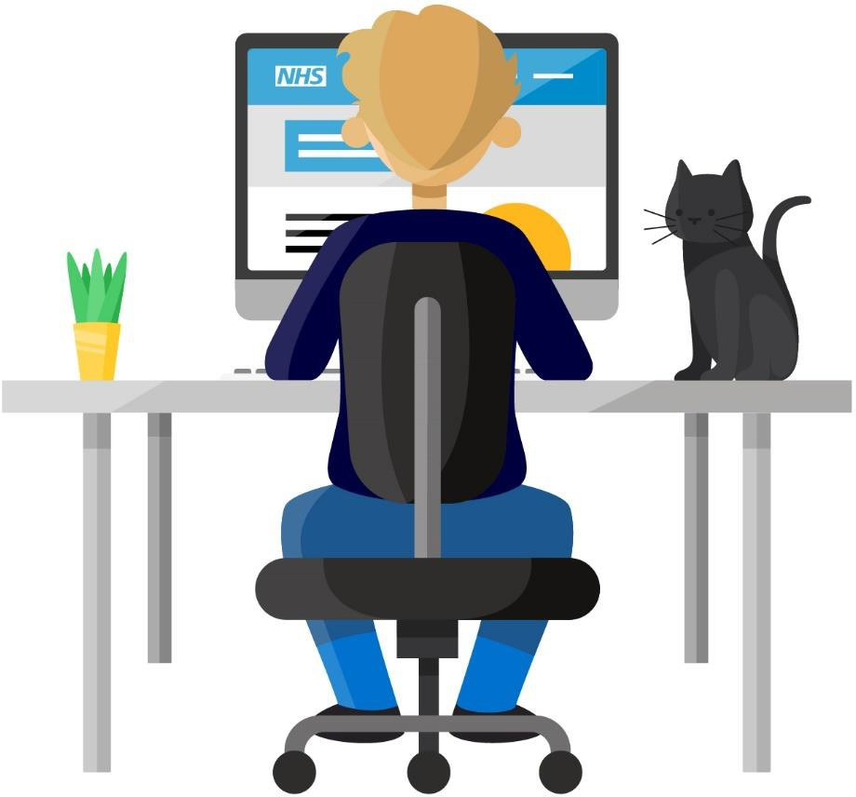
Have your say
We would like to invite you to complete an anonymous questionnaire that offers an opportunity to provide feedback on the wellbeing support available nationally to all NHS staff.
This questionnaire will take approximately 10 minutes to complete and any responses submitted will be valuable in helping us shape the national offer.
You can access the survey here:
https://nhsei-hwb.onlinesurveys.ac.uk/supporting-our-nhs-
people-your-feedback
Thank you for taking the time to submit your views.

